Slide 1

Intelligent Accident Management System
Group No. 20
Student ID Student Name
16104027 Kunal Kale
16104044 Viranchee Patil
16104023 Chinmay Kubal
Project Guide: Prof. Poonam Dhawale

Slide 2
Contents
Abstract
Introduction
Objectives
Literature Review
Problem Definition
Existing System Architecture/Working
Proposed System Architecture
Technology Stack
Working
Scope of Project
Limitations
References

Slide 3
Abstract
The Indian Ministry of Road Transport and Highways reports that around 4,06,730 accidents take place each year and close to 86,000 are killed! In frequently crowded areas like cities or highways, more than 65% lives are lost due to delay in the arrival of emergency services. If we consider accidents taking place in secluded areas,then the percentage of lives lost is even more. With an aim to reduce these numbers to as little as possible, we propose a system which makes use of IoT sensors along with Cloud Computing.

Slide 4
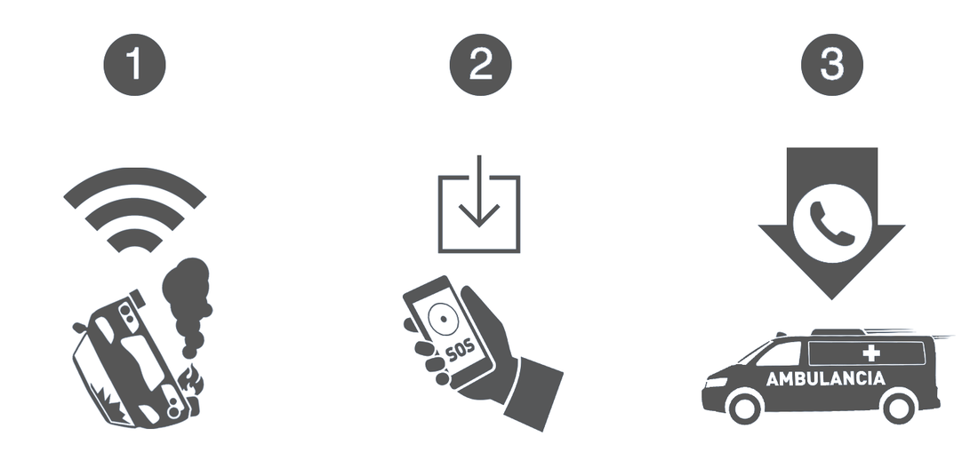
Introduction
In our project, we present the modelling, implementation and testing of a Smart Accident Management system based on IoT and Cloud Computing.
At the time of accident, IoT sensors will be used to determine the impact of damage caused by the collision. Based on the impact index, a text message will be sent to nearby authorities and/or emergency service providers.

Slide 5
Objectives
To reduce the number of car crash fatalities by a considerable amount.
To develop a cheap state-of-art system for vehicles.

Slide 6
Literature Review
Paper Title | Year | Limitation(s)
Real-Time Crash Detection Analysis and Emergency Alert Using Smartphone. | 2016 | Smartphone can get totally destroyed.
Intelligent Accident Management System Using IoT and Cloud. | 2016 | Makes use of a Microcontroller.

Slide 7
Problem Definition
To create an assistive system for car crash victims which will automatically alert nearby authorities who can arrive on the scene in quick succession of time, thereby possibly saving the victim's life. Based on the impact of collision, the system will automatically send a notification to the service stations, local clinics, police stations, hospitals, etc.

Slide 8
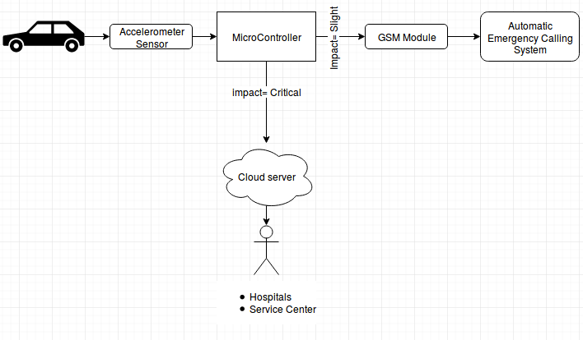
Existing System Architecture

Slide 9
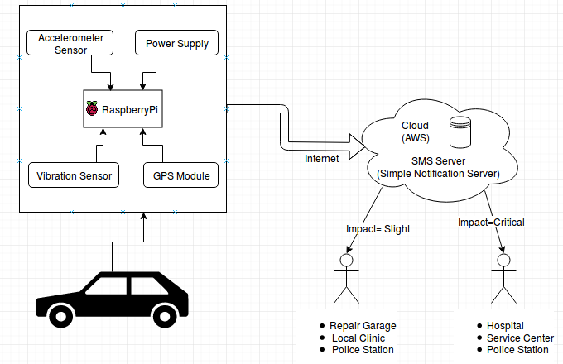
Proposed System Architecture

Slide 10
Working
At the time of collision, the accelerometer will detect an abnormal change in the acceleration. This change in acceleration will be mapped on an intensity scale.
The exact coordinates of the crash will be determined with the help of a GPS module and they will be sent to the Cloud.
If impact is low, Cloud will send an emergency alert to the nearby clinics, garages, etc.
If impact is high, Cloud will send an emergency alert to the nearby Hospitals, Service Centers, Police Stations, etc .

Slide 11
Conclusion
With the ever increasing number of vehicles, the number of accidents taking place is also increasing exponentially. In order to aid the car crash victims, we propose a system that makes use of various IoT sensors that are capable of determining the collision impact and sending automatic alerts to the help providers.
Also, the implemented system will be a lot more cheaper than the automatic accident detection systems that are currently present only in high-end cars.

Slide 12
References
[1] https://ieeexplore.ieee.org/document/7877395
Intelligent Accident Management System using IoT and Cloud
Akriti Singhal ; Sarishma ; Ravi Tomar
October, 2016
[2] https://ieeexplore.ieee.org/document/7800181
S-CarCrash: Real-time crash detection analysis and emergency alert using smartphone
Harit Sharma ; Ravi Kanth Reddy ; Archana Karthik
September, 2016

Slide 13
.
THANK YOU !!

